Slide 1
Workshop on archery rules & procedures
28 Oct 2017 Saturday, 1900 – 2130h
Sports Singapore – Gold Room
Speakers: AAS Judges
Registration: www.tinyurl.com/registerAAS-JCworkshop
Enquiry: www.tinyurl.com/askAASjudges
WA Rule books: https://worldarchery.org/Rules
Bylaws: https://extranet.worldarchery.org/documents/index.php/html/?dir=151

Slide 2
Topic
Shooting and conduct
Order of shooting and timing control
Scoring
Unsportmanlike behaviour
Common error by archers
Coaches
How to read matchplay charts
Major event
Q&A

Slide 3
Shooting and conduct
Knows the target face, no of arrow to shoot and timing. For indoor, triple face shooting
Individual qualification/elimination: Non alternate 40s/arrow, alternate shooting / team elimination 20s/arrow
Athletes may not raise the bow arm until the signal to start shooting is given. / Pulling of bow without arrow is only allowed at the shooting line.
What happens if archer released an arrow after practice has closed and before start of competition
Highest scoring arrow becomes an M
Still shoots the required number of arrow for the end, 3 or 6.

Slide 4
Shooting and conduct
What happens when archer has a faulty equipment/medical issue?
Archer to inform judge directly, with the fault and the no of arrow he has shot
Judge/medical personnel to determine if is is a equipment failure/medical issue
Inform judge if the fault can be fixed before the current end is finished or more time is needed.
What is the time allowed for equipment failure / can the archer take his own sweet time to fix his equipment?
Muscular stress or injury is not considered as equipment failure.
Equipment failures and stoppage for medical reasons cannot be permitted at the elimination and final stages of the competition.

Slide 5
Shooting and conduct
Do archers continue to shoot when the all timer stop suddenly/target face comes off?
Stop shooting, inform the judge, awaits instruction from DoS/judge
Do archers continue to shoot when only one timer stops suddenly but other timer is working?
Continue shooting
The archer beside me screams suddenly and I was shocked and released my arrow, is this arrow counted?
Yes, responsibility lies in the archer to control and manage

Slide 6
Shooting and conduct
High draws
Danger/safety
12.9. The Director of Shooting shall be advised if an athlete, when drawing back the string of his bow uses any technique which, in the opinion of the Judges, could allow the arrow, if accidentally released, to fly beyond a safety zone or safety arrangements (overshoot area, net, wall etc.). If an athlete persists in using such a technique, he shall, in the interest of safety, be asked by the Chairperson of the Tournament Judge Commission or the Director of Shooting to stop shooting immediately and to leave the field.

Slide 7
Shooting and conduct
Missing arrows
Inform judge
Else, any arrow found may be counted towards part of the end, which would result in shooting extra arrows.
Coaching on the shooting line
Archers may receive non electronic instructions from the coach while on the shooting line
The athlete is not to speak from the shooting line. That may easily cause a disturbance to the other athletes.
Archer may step off the shooting line, if needed. Be aware that the timing is counting down. It is the responsibility of the athlete to return to the line before the end is finished.

Slide 8
Shooting and conduct
3M line
During Qualification
What happens if my arrow drops
within the 3M line?
out of the 3M line?
What happen If I am not sure if my dropped arrow is within or out of the 3M line?
Can I call for equipment failure?
Check your equipement for cause of dropped arrow
During Elimination
What happens if my arrow drops
within the 3M line?
out of the 3M line?
What happen If I am not sure if my dropped arrow is within or out of the 3M line?
Notes:
During elimination outdoors, consider shooting an arrow since the worst thing that can happen is the miss will be scored which would have happened anyway.

Slide 9
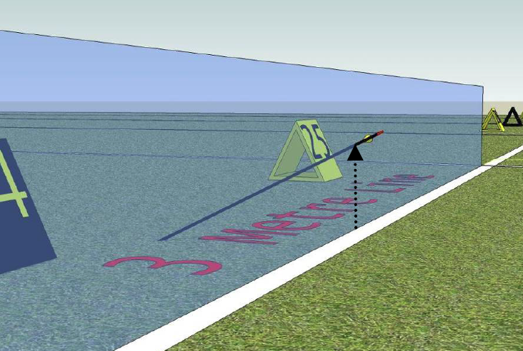
Shooting and conduct
3M line
Are all arrows that fall and cross the 3M line considered shot?
What if an archer brushes the adjacent archers quiver and an arrow in the other archers quiver inadvertently comes out and cross the three meter line?
In indoor, an arrow hit the target and rebounded, landing back within the 3M line. Is this arrow considered unshot?

Slide 10
Shooting and conduct
Team event violations – minor / yellow card
(a) two athletes cross into the area between the one metre line and the shooting line at the same time. For consistency in judging we assume that this has taken place when both athletes have one foot each on the ground in the one metre area.
(b) an athlete whilst leaving the athlete's’ box and proceeding to the shooting line, removes her/his arrow from the quiver, and in doing so exposes the point of the arrow before straddling the shooting line.
(c) an athlete crosses the one meter line before the count-down clock for his team starts counting down.
Penalty: time Archer to return to team waiting line and return (without arrow visibly out)

Slide 11
Shooting and conduct
Team event violations – major / red card
(a) Ignoring the yellow card (the athlete shoots without returning behind the 1m line)
(b) Shooting an arrow before or after time
(c) Shooting out of sequence (Shooting when it is the other team’s turn to shoot
(d) A team member shoots more than one arrow in one of the two halves when shooting alternately.
Penalty: score Highest scoring arrow will be scored and given an M.

Slide 12
Order of shooting and timing control
Where do Archer A, B and C stand?
What can I do when
another archer is standing at my position?
another archer is standing very close to me?
another archer’s scope is in my space?
Can we change our shooting position if all archers on the board are agreeable?
Yes for qualification, and you must inform the judge regarding the change
No for match play.

Slide 13
Order of shooting and timing control
Alternate shooting
In single match play with alternating shooting, the higher placed athlete in the Qualification Round shall decide the order of shooting of the first end/set.
The athlete with the lower set points score for recurve or lower cumulative score for compound shall shoot first the next end/set.
If the athletes are tied (5-5), the athlete who shot first in the first end/set shoots first in the next end/set or in the shoot-off.

Slide 14
Order of shooting and timing control
Alternate shooting
Team elimination Archers from team A to shoot an arrow each, A’s timer stops when last archer crosses the team waiting line. Team B’s archers to start shooting when their timer start.
What happens when 2nd archer from Team A shot two arrows instead of one? In the first half? In the second half?
If the situation occurs that during alternate shooting an athlete of the team shoots more than one arrow in the first end, the team will be given a red card and lose the highest score of that end. This athlete has then finished his shooting and only the two other athletes will shoot their arrows in the second half of the end.
If an athlete shoots more than one arrow in the second half, still a red card will be given and the team will lose the highest score of the end. But then you will also have a “seven arrow issue” to deal with.

Slide 15
Order of shooting and timing control
Ties/shoot-off
Shoot-off for entry into match play / medal positions
For other positions, to be decided by
Number of 10’s and X’s (number of 10’s for indoor)
Then by number of X’s (number of 9’s for indoor)
lastly coin toss
Team Shoot off - deciding into entrance of Elimination phase
Archers of a team shoots together, one arrow each, 40s
A team (when having shot at multiple centres) have one face for each team member.
Team Shoot off - during elimination phase
Archer of a team shoots after one another, one arrow each, 60s/40s (mixed team)
Team alternate shoot off
Alternate after every arrow, Team A-1, Team B-1, Team A-2, Team B-2, Team A-3, Team B-3, if team A shot first at the start.

Slide 16
Order of shooting and timing control
Forfeited matches
If an athlete (or team) is not present at the time of determining who starts shooting when single matches are shot alternately, then the athlete present will be declared the winner of the match.
If an athlete (or team) is not present when the shooting starts in an elimination round match of the competition, the opponent will be the winner of the match. As the start shooting signal will be decisive here, the athlete present may shoot the first end, but no scoring takes place. He/she will normally be allowed to continue practicing on his/her target (in set shooting up to maximum three ends) during this stage.

Slide 17
Scoring
Set scoring for recurve eliminations
The winner of the set is awarded 2 points, if the set is a tie then each athlete is awarded 1 point, the athlete losing the set receives no points.
The first athlete reaching six (6) points wins the match.
If the athletes are tied at the end of the match, a one arrow shoot-off determines the winner, the winner of the shoot-off get an additional point.
Cumulative scoring for compound eliminations
Outdoor Compound team elimination on two target faces
if the team, by a mistake or miss, end up with four arrows in one of them, the highest value of that target face becomes a Miss.

Slide 18
Scoring – team elimination
Face 1
Face 2
X, 10, 8, 7
10, 7
Scoring: penalty
X from face 1 will be scored as M.
Final:
10, 10, 8, 7, 7, M

Slide 19
Scoring – team elimination
Face 1
Face 2
X, 10, 8, 7
10, 7, 6
Scoring: 1st penalty
X from face 1 will be scored as M.
2nd penalty:
10, 10, 8, 7, 7, 6, M
Final: lower 6 arrows
10, 8, 7, 7, 6, M
Double penalty.
Never shoot more than the allowed number of arrows

Slide 20
Scoring
Indoor vertical triple face scoring (compound and recurve)
One face one arrow
If there are two arrows on a face, the higher arrow will be scored as M.
I shot an arrow into the top and middle face, my third arrow, though aimed at the bottom face, landed on the middle face. Should I shoot one more arrow into the bottom face?

Slide 21
Scoring
What do I do if I have shot a missed arrow that I cannot find it beyond the target?
Report to the judge your missing arrows.
If more than the required number of arrows should be found in the target butt or on the ground near the butt, or in the shooting lanes, only the lowest three (or six, as the case may be) in value shall be scored. Athletes or teams found to repeat this offence may be disqualified.

Slide 22
Scoring
Pass through / bouncer
No arrow found, no score?
Once located, do not touch but wait for the judge. Score the rest of arrows.
An arrow found on the ground in the shooting lane or behind the target butt, which has been claimed as a bouncer or pass through, shall, in the opinion of the Judge(s), have first hit the target butt. If more than one unmarked hole is located in the scoring zone of the target face after a bouncer or pass through has occurred, the value of the lowest scoring hole shall be given to the athlete, unless physical evidence may give the correct score of the arrow.

Slide 23
Scoring
Scoring
I shot more than the required number of arrows.
I shot an arrow after the timer sounded.
My arrow landed on another face.
Official practice has closed, but since there is nobody, I practice on my own.
(indoor vertical triple face) I have two arrows on the top face.

Slide 24
Scoring
Scorecards: paper or electronic
If there is a discrepancy in the arrow values between an electronic and a paper scorecard, the paper card will take precedence.
The organisers are not required to accept or record scorecards that have not been signed, and/or do not contain the sum total, and/or the number of 10's and/or the number of X's (or 9s for indoor) and/or which contain mathematical errors.
The organisers or officials are not required to verify the accuracy of any submitted scorecard, however if the organisers or the officials note an error at the time of submission, they will ask the athletes concerned to correct such error and the result as corrected will stand.

Slide 25
Scoring
Scorecards: paper or electronic
Should a discrepancy be found in the sum total where:
two paper scorecards are used, the sum total of the lower arrow scores will be used for the final result;
if the score on a single scorecard (and in the case of double scoring, the score is the same on each scorecard), is lower than the actual score, the lower score on the scorecard will be used,
one paper scorecard and one electronic scorecard are used, the total of the electronic scorecard will be used for total score, 10s and Xs on the following conditions:
a total score has been entered on the manual scorecard so verification is possible;
in case no 10s and Xs (9s for indoor) are entered on the manual scorecard, no 10s and Xs (9s for indoor) are registered;
in case no total score is entered on the manual scorecard when it is submitted to the results team, then the athlete shall be disqualified (individual/team and mixed team where applicable).

Slide 26
Penalties
Major / red card
Losing highest scoring arrow values
Important: write down the original value arrow
Judge: cross and mark with “M”, initiate
Rationale: can be appealed
Minor / yellow card
Warning
May result in loss of time
Cannot be appealed
No point asking what went wrong / arguing during team event
Be clear: Crossing 1M line / taking arrow out of quiver while crossing
Red card may not have to be shown to disqualify scores, it is for general information only.

Slide 27
Unsportmanlike behaviour
Verbal insults directed to a Judge, by either an athlete or an official representing the athlete should be dealt with calmly by issuing a warning to the team manager, indicating that the athlete may be disqualified if further verbal insults are heard.
In no instance should physical actions directed at the Judges or tournament officials be tolerated, physical contact or aggression will lead to immediate disqualification.
Towards fellow competitors

Slide 28
Common error by archers
Pulling of bow other than at the shooting line
Verbal communications from the shooting line
Shorts that are shorter than the fingertips extended
Scoring
Touching face/arrows/butt before all scoring is completed
Pushing back arrows that went into the buttress to score
Arrows embedded in the butt and not showing on the face can only be scored by a Judge.
Looking for missing arrows behind buttress before scoring is done.
Marking of arrow holes

Slide 29
Marking of arrow holes

Slide 30
Coaches
Where do coaches stand during competition
During controlled practice
Qualification/elimination?
1 archer/team to one official
The link to the athletes

Slide 31
How to read matchplay charts
Left
Right
Target
It is not always true that the higher ranking archer is always on the left/right.

Slide 32
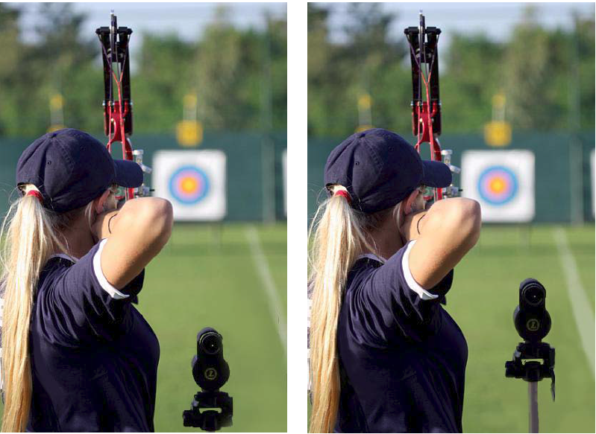
Major events
Equipment inspection
At designated area, announce by DoS
Accompanied by team manager/coach, in shooting uniform
During official practice, the day before competition
In alphabetical order
Show all equipment to be used including spares
Para athletes need to bring along classification cards
*Camouflage attire/equipment
Scope
Which is correct?

Slide 33
Major events
Uniform for athletes and team officials: official practice and competition
All members of one team by category shall be dressed in the same team uniform. The teams of one country may wear different design and colour uniforms. Team officials may wear a different style but should wear the same colours and should be easily identified as the official of their team;
Women shall wear dresses, skirts, divided skirts, shorts (these may not be shorter than the athlete’s fingertips when the arms and fingers are extended at the athlete’s side) or trousers, and blouses or tops (covering the front and back of the body, be fixed over each shoulder while still covering the midriff when she is at full draw);
Men shall wear trousers or shorts (these may not be shorter than the athlete’s fingertips when the arms and fingers are extended at the athlete’s side) and long or short sleeved shirts (covering the midriff when at full draw);
No denim or jeans, regardless the colour, or camouflage clothes and equipment may be worn nor any oversize or baggy type pants or shorts;
During the Team and Mixed Team match play competition the same colour and style shirt/blouse/top and the same colour pants/shorts/skirts shall be worn;
Due to weather conditions, protective clothing such as sweaters, track suits, raingear, etc. may be worn following approval by the Technical Delegate of the event or, in his absence, the Chairperson of the Tournament Judge Commission;
Headwear is optional.
Sport shoes shall be worn by all athletes and officials except for disabled athletes when included on their classification card. Sport shoes may be different styles but shall cover the entire foot.
At Olympic Games, World Championships and World Cup Events, all athletes shall have their name across the back on the shoulder area in combination with the name of their country (or three letters acronym). Team officials shall have their country name on the back of their shirt. The name and function of the team official are optional.
No advertising of any kind whatsoever shall appear on clothing worn by the athletes or officials at any time during the tournament except as specified in the eligibility rules.

Slide 34
Major events
Scoring
Familiar with the use of scoring using PDA
Responsibilties of scoring
After qualification
Wait for announcement for any shoot off before dismentling equipment, unless confident of no tie.

Slide 35
Q&A
Send in your questions to
www.tinyurl.com/askAASjudges

Slide 36
Q&A
How about arrow into another arrow? How do you score? Is it same as the first arrow score?
I have a question on bounce arrow, how would you score a arrow that bounces on the same arrow hole that have already marked earlier?
Two archers both had a bouncer and two unmarked values are located, how are the bounced arrows scored?
Two archers both had a bouncer and THREE unmarked values are located, how are the bounced arrows scored?
Another arrow hitting on an arrow on target and deflected, it is hanging mid air without touching the face and part of the arrow hanging onto the first arrow it hit before deflected. What is the score of this arrow?

Slide 37
Q&A
I have a pass through, there is an unmarked hole on the face, but I cannot find my arrow. Can I be awarded the value of the unmarked hole?
I have a bouncer, with the arrow landed on the ground in front of the butt, but there is no unmarked hole. How should I score?

Slide 38
Case study – Coaching during controlled practice
Archer on Target 1A complained to the judge after the first end of controlled practice that the coach of Archer 1B is standing directly behind the archer to give guidance.

Slide 39
Case study – Leaving the line during shooting / Loud cheering vs unsportmanship
A) During a big junior archery event, there is a good atmosphere on the stands with lots of groups cheering their favourite, quite loudly. One archer has problems in receiving guidance from his coach and thus leaves the shooting line now and then during shooting, shortly discussing something with his coach then returning to the shooting line.
B) When the archer left the line to discuss with his coach, he has one arrow left to shoot. Seeing the line is clear (before the time is up), the DoS indicated the end of time. The archer did not manage to shoot his last arrow.
C) The coach made a complain against the loud noise.

Slide 40
Case study – Shooting after emergency stop / accidental release
A series of sound signals is suddenly given in the middle of an end because a dog has entered into one side of a large field. One archer seeing that the dog is far away from his target, so he shoots his last arrow of that end some seconds after the warning stop signal.
On one location on the shooting line, archer A, leaving the shooting line after finishing his shooting, bumped into the archer next to him (archer B), causing archer B to release his arrow. The arrow missed the target by far. Archer A admitted that he accidentally bumped into archer B.

Slide 41
Case study – Make-up arrows for equipment failure
At an event you were called to the line by an archer, quite a new one, who has an equipment failure with his sight and has one arrow left to shoot. Awaiting his repair you let the shooting proceeds. After the next end you approach the archer to find out how his repair is going. He looks a bit astonished at you and tells you that he shot his remaining arrow together with the three other arrows in the end just finished, as he had repaired his sight quite rapidly.

Slide 42
Case study – Scoring after arrows are withdrew
You are called to a target because one of the archers at that target, by mistake, withdrew his arrows before they were scored. There were only six unmarked holes in the target face: 10-10-9-9-8-7. How would you score if
A) this was the first end?
B) this end if this was the fifth end?

Slide 43
Case study – Arrows shot after time / 3M line
An archer had difficulty in pulling and completing his shooting of an end of three arrows, and he released his third arrow after the stop signal and the arrow dropped within the three (3) meter line. The other two arrow values were 10 and 9.

Slide 44
Case study – Pass through
During one end of scoring, one archer from target 25 called you, the judge, as he claimed he had a pass through. He was unable to find his missing arrow, there was one unmarked hole in the ten-ring. His other arrows were X, X, X, 10, 9.
Just as the scorer was about to write down the scores, one archer spotted an arrow protruding from the ground, should the archer pluck it off the ground or wait for the judge to examine the arrow?
During compound qualification, one archer has his arrow partially embedded in the target buttress. You happened to see him pushing the embedded arrow from the back of target towards the face, to try to score his arrow.

Slide 45
Case study – Arrows found near target during scoring
At an event an archer picks up a fourth arrow behind the target in addition to his three arrows in the target. The archer claims that the arrow is an arrow from the warming up period, and the other archers on that target confirm that he lost an arrow during the warm up.

Slide 46
Case study – Importance of marking arrow holes
You are called to a target where a bouncer has occurred. You find that the position of the arrow confirms that the arrow has bounced off. You realize that one of the arrows, a 9 has a damaged nock, but you also find an unmarked hole in the 7-zone.

Slide 47
Case study – Scoresheets and electronic scoring
Archer whose score was ranked the highest submitted his scoresheet without signing as he was overjoyed. When the results was published, he was shocked to see that he could not find his name from the top. In fact, he was ranked last.
Archer A was in charge of writing the scorecard while archer C was in charge of electronic scoring. At the end of the round, archer C realised there was a difference in the score between the paper and electronic scoring. The electronic score was higher and archer C insisted that the electronic score was the correct one.

Slide 48
Case study – Forfeited match
At the start of an elimination round (matches), archer A is not present, even after the shooting was held back a couple of minutes. The Judge then declared his opponent B the winner of that match by forfeit. Then shooting starts, and after two sets the missing archer turns up and starts shooting alongside his opponent who at that time is practicing on the target. Archer A admitted he did not shoot the first two sets, but said he was capable of winning the next three and thereby the match.
Notes:
AT which point do we determine the match to be a forfieted match

